Slide 1

ENERGY CONSUMPTION ANALYSIS
Presented By:
E. Praneeth
M. Sathwik
Y. Surya Teja
Batch No: 456

Slide 2
Agenda
Business Problem
Objective of the Project
ER Diagram and schema explanation
Key analysis questions (use cases)
SQL query results with screenshots or summaries
Final business insights
Recommendations
Conclusion (Key finding overall)
Your Experience/Challenges working on SQL – Data Analysis Project.
Q&A Slide

Slide 3
Business problem :
Rising energy demand and emissions make it difficult to balance economic growth with environmental sustainability.
There is a lack of integrated data analysis linking energy consumption, production, emissions, GDP, and population.
Decision-makers struggle to identify inefficiencies and compare country-level performance using reliable insights.
This project uses SQL-based data analysis to evaluate how energy use, economic growth, and population trends impact global carbon emissions, helping identify high-impact countries, efficiency patterns, and sustainability opportunities.

Slide 4
OBJECTIVE
The objective of this project is to analyze global energy consumption, emissions, GDP, population, and energy production data using SQL to identify trends, relationships, and country-level contributions.
Goals:
Understand emission patterns across countries
Compare energy consumption with economic indicators
Analyze per-capita energy and emission metrics
Identify key drivers of global energy usage

Slide 5
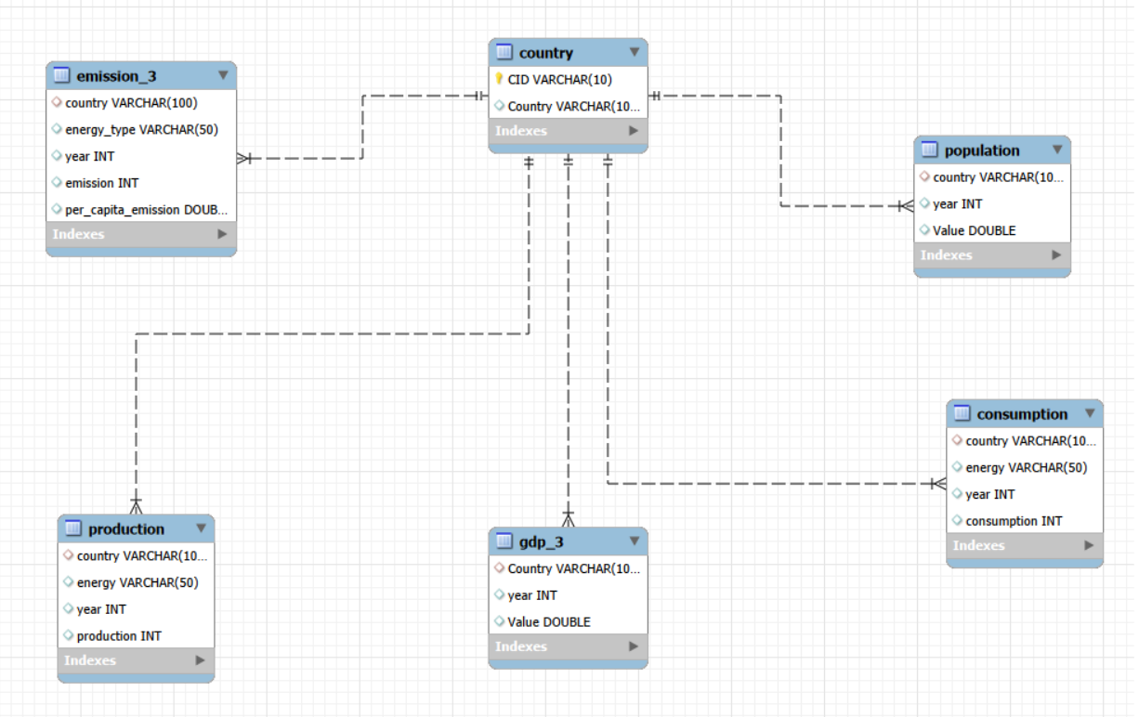
ER Diagram
The project consists of six tables: Country, Consumption, Production, Emission, GDP, and Population.
Each table is connected using Country as the primary linking attribute.
Time-based analysis is performed using the Year column.
Foreign key relationships ensure referential integrity across datasets.
The ER diagram represents relationships between all energy-related datasets.

Slide 6
Database Schema Overview
Country Table
Contains unique list of countries with country identifiers.
Acts as the reference table used to connect all datasets through the country field.
Population Table
Stores yearly population values for each country.
Used for per-capita calculations such as emissions per capita and energy consumption per capita.
GDP_3 Table
Contains yearly GDP values for each country.
Enables economic comparison with energy consumption and emissions for efficiency analysis.

Slide 7
Database Schema Overview
Emission_3 Table
Contains CO₂ emissions by country, year, and energy source.
Used to analyze emission trends, global emission share, and emission intensity.
Production Table
Stores yearly energy production values by country and energy type.
Helps evaluate production capacity and production-per-capita metrics.
Consumption Table
Contains yearly energy consumption by country and energy type.
Used to analyze energy demand patterns and consumption-to-GDP efficiency.

Slide 8
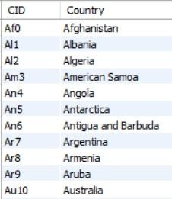
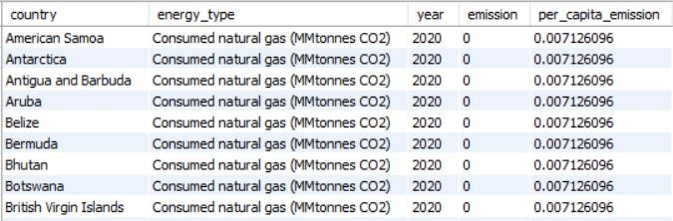
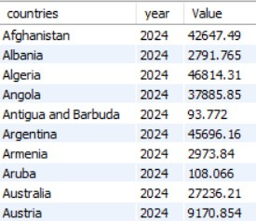
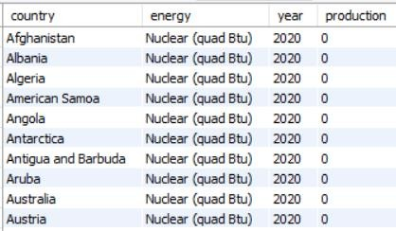
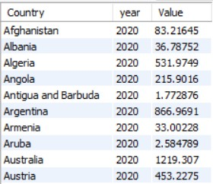
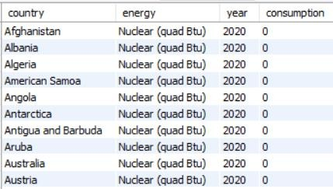
Tables :
Country
Emission_3
Population
Production
GDP_3
Consumption

Slide 9
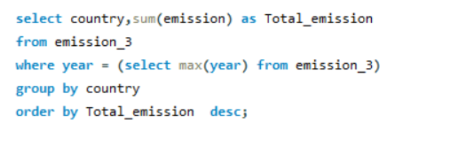
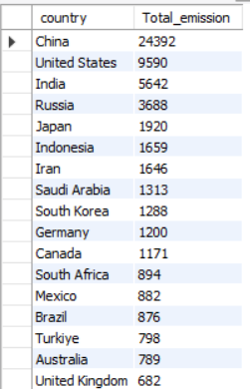
Key Analysis Questions :
What is the total emission per country for the most recent year available?
Query
Output
Units: kt CO₂ (kilotons of CO₂)
Insight
China and the United States are the largest contributors to global emissions

Slide 10
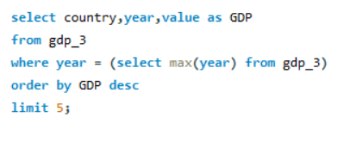
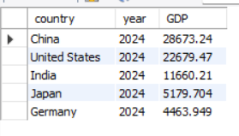
What are the top 5 countries by GDP in the most recent year?
Query
Output
Insight
Units: USD
China and the United States dominate global GDP rankings in the most recent year.

Slide 11
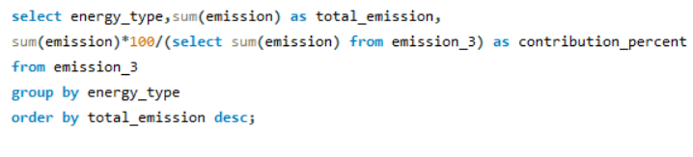
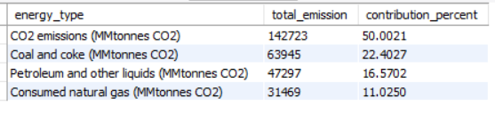
Which energy types contribute most to emissions across all countries?
Query
Output
Insight
CO₂ emissions dominate the total emission share, with fossil fuel sources such as coal, petroleum, and natural gas contributing the majority of global emissions.

Slide 12
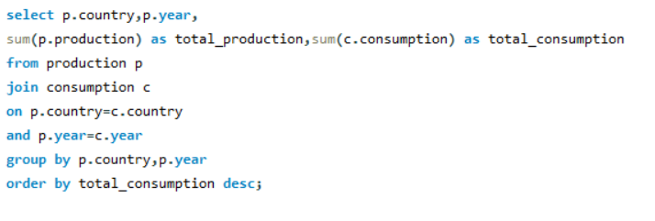
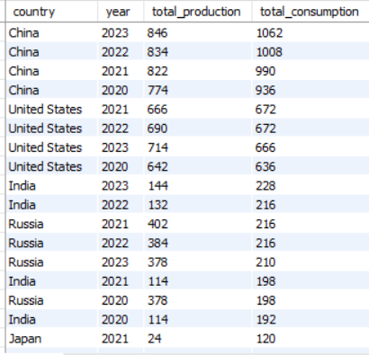
Compare energy production and consumption by country and year.
Query
Output
Insight
Several countries show higher energy consumption than production, indicating dependence on energy imports to meet domestic demand.

Slide 13
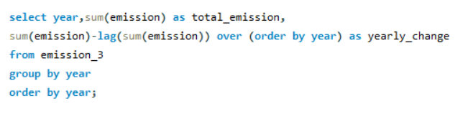
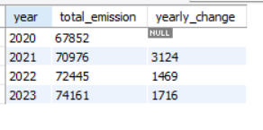
How have global emissions changed year over year?
Query
Output
Units: kt CO₂ (kilotons of CO₂)
Insight
Global emissions show a consistent upward trend, indicating increasing energy demand and industrial activity over the observed years.
Emissions increased steadily each year, with the largest rise observed between 2020 and 2021.

Slide 14
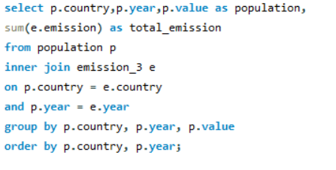
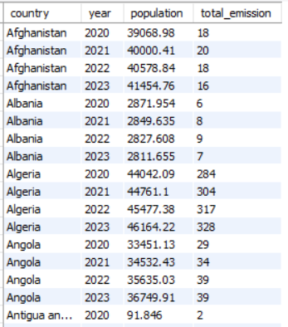
How has population growth affected total emissions in each country?
Query
Output
Units: kt CO₂ (kilotons of CO₂)
Insight
Population growth is generally associated with an increase in total emissions across many countries, indicating that demographic expansion contributes to higher energy demand and environmental impact.

Slide 15
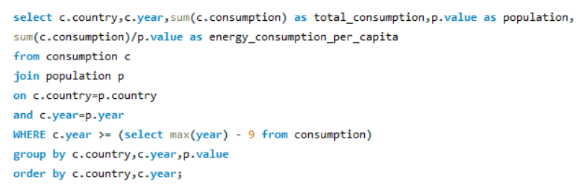
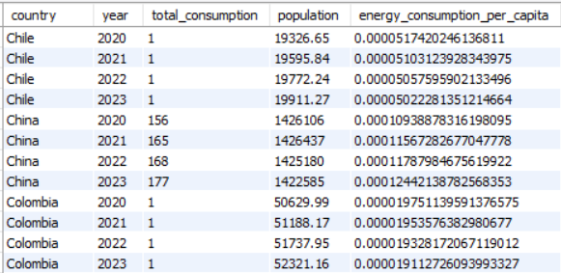
What is the energy consumption per capita for each country over the last decade?
Query
Output
Insight
Per-capita energy consumption varies significantly across countries, with developed economies generally showing higher consumption levels compared to developing nations.

Slide 16
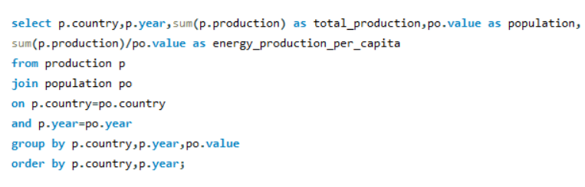
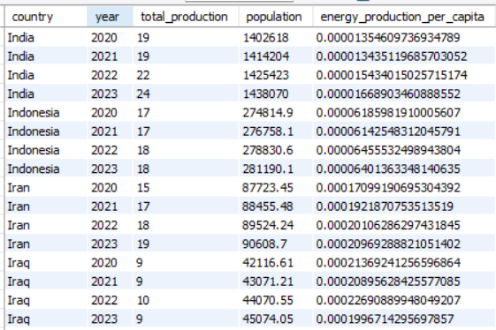
How does energy production per capita vary across countries?
Query
Output
Insight
Energy production per capita differs significantly across countries, reflecting variations in resource availability, infrastructure development, and industrial capacity.

Slide 17
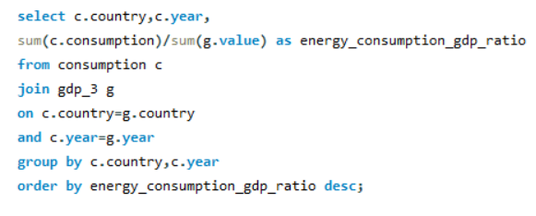
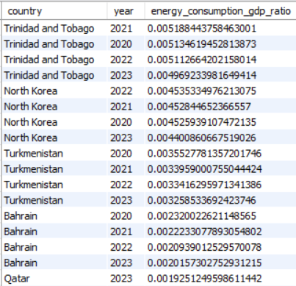
Which countries have the highest energy consumption relative to GDP?
Query
Output
Insight
Countries such as Trinidad and Tobago, North Korea, and Turkmenistan show the highest energy consumption relative to GDP, indicating higher energy intensity compared to larger economies like the United States, China, and India, which demonstrate comparatively lower energy consumption per unit of economic output.

Slide 18
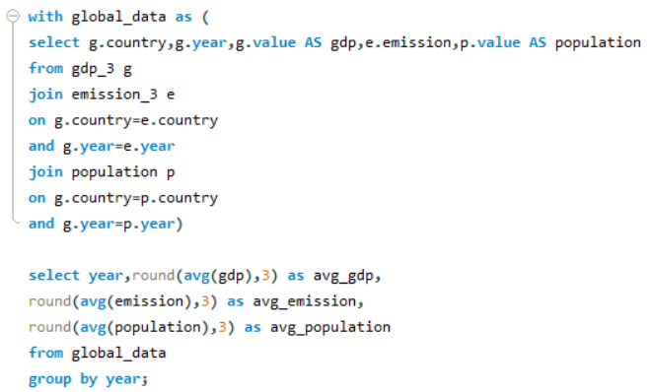
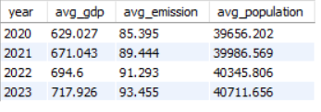
What is the global average GDP, emission, and population by year?
Query
Output
Insight
The global average GDP, emissions, and population show a steady increasing trend over the years, indicating rising economic activity accompanied by gradual growth in emissions and population.

Slide 19
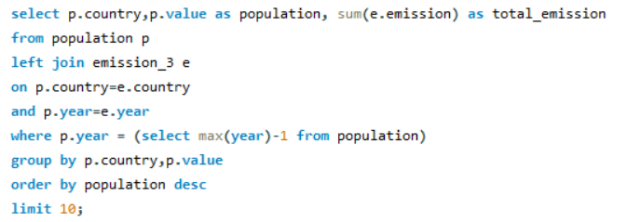
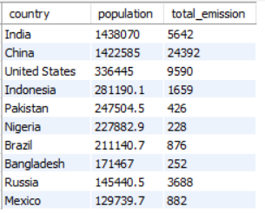
What are the top 10 countries by population and how do their emissions compare?
Query
Output
Insight
Highly populated countries such as China, India, and the United States contribute significantly to total global emissions, indicating that population size plays an important role in overall emission levels, although emission intensity varies across countries.

Slide 20
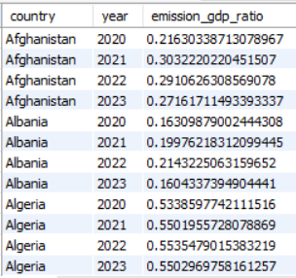
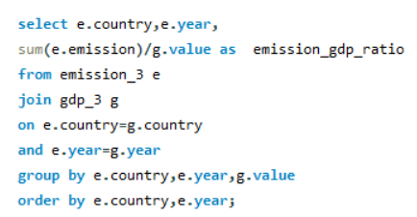
What is the emission-to-GDP ratio for each country by year?
Query
Output
Insight
The emission-to-GDP ratio measures how much carbon emission is generated for each unit of economic output, helping identify countries with higher carbon intensity and lower production efficiency.

Slide 21
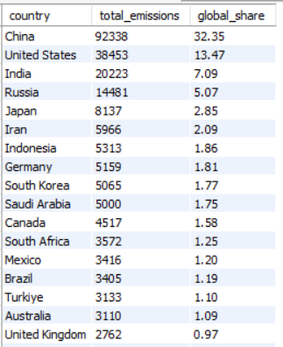
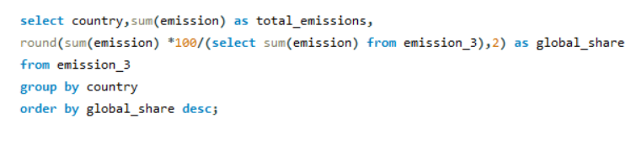
What is the global share (%) of emissions by country?
Query
Output
Insight
China accounts for the largest share of global emissions (over 30%), followed by the United States and India, indicating that a small group of countries contributes a significant proportion of total global emissions.

Slide 22
Key Insights :
Emissions are highly concentrated among a few countries
China, the United States, and India together account for a very large share of global CO₂ emissions, indicating that global climate strategies must strongly involve these economies.
Fossil fuels dominate emission sources
Coal and oil-based energy sources contribute the majority of global emissions, showing that transitioning to renewable energy remains the most critical pathway for emission reduction.
Population size strongly influences total emissions
Countries with large populations (India, China, Indonesia) show higher total emissions, even when their per-capita emissions are comparatively lower.
Energy consumption relative to GDP varies widely
Some resource-dependent economies consume significantly more energy per unit of GDP, indicating lower energy efficiency compared to developed economies.
Per-capita production and consumption trends highlight development differences
Developed economies show higher per-capita energy usage, while developing countries demonstrate rising trends driven by industrial growth and urbanization.

Slide 23
Recommendations :
Accelerate the adoption of renewable energy sources to reduce emissions and lower dependence on fossil fuels.
Enhance energy efficiency by implementing cleaner technologies, upgrading infrastructure, and optimizing energy management systems.
Support data-driven policy and business decisions through continuous monitoring of energy, emission, GDP, and population trends.
Increase investments in low-carbon and sustainable technologies to ensure long-term environmental and economic stability.
Strengthen global cooperation and benchmarking to learn from high-efficiency countries and implement best energy practices.

Slide 24
Conclusion :
Energy consumption and emissions are heavily concentrated in a few major economies due to large populations, industrial expansion, and strong economic activity.
Fossil fuels such as coal, oil, and natural gas remain the dominant contributors to global emissions, indicating a strong connection between energy usage patterns and environmental impact.
Several countries demonstrate higher energy efficiency by generating greater economic output with comparatively lower emission levels.
Renewable energy adoption and efficiency improvements are critical to reducing emissions while supporting economic development.

Slide 25
Experience/Challenges
Worked extensively with SQL joins, window functions, and aggregations to transform raw multi-table datasets into meaningful analytical insights.
Designing correct joins between multiple tables without duplication errors.
Gained practical experience converting analytical questions into optimized SQL queries and presenting results as business insights for decision-making.

Slide 26


Slide 27

THANK YOU

